Slide 1

SMARTPHONE CONTROLLED ELECTRIC SKATEBOARD
Submitted By : Suchika Raturi Uni Roll Num :
Under the mentorship of
Dr. Sachin Sharma
Professor

Slide 2
INTRODUCTION
A conventional skateboard with certain additional pieces connected is known as an electric skateboard.
An electric skateboard is a vehicle that is utilized to cover small distances in a short amount of time.
These are more ecologically friendly than traditional cars.
The basic principle of this project is that the wheels are connected and the motors that link the wheels are powered by a battery pack with a sufficient range, which turns the motor, causing the skateboard to move.

Slide 3
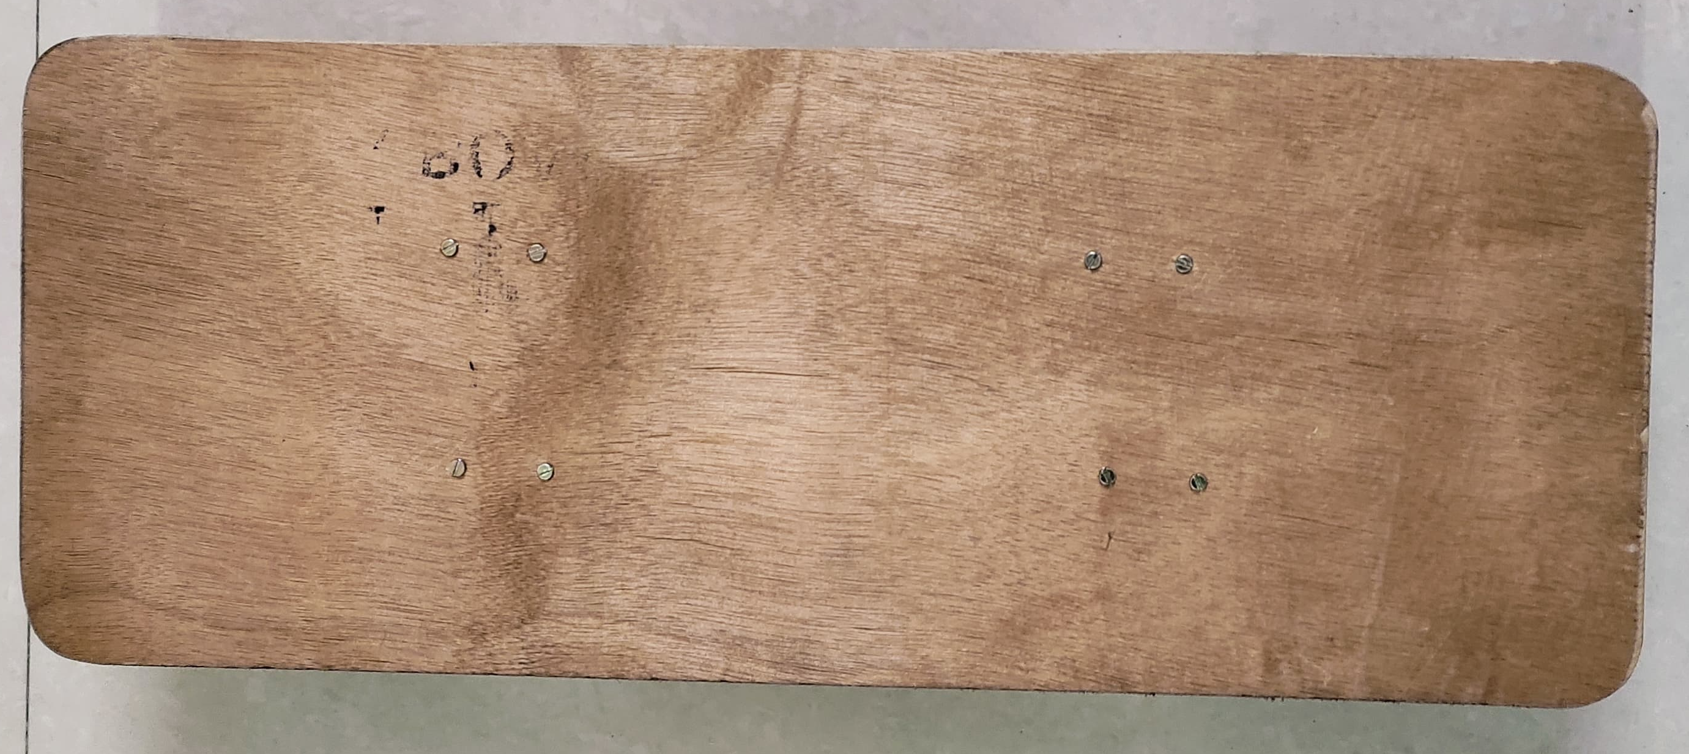
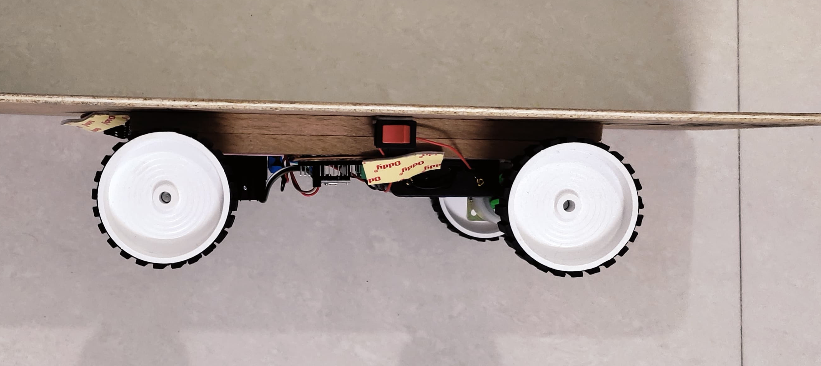
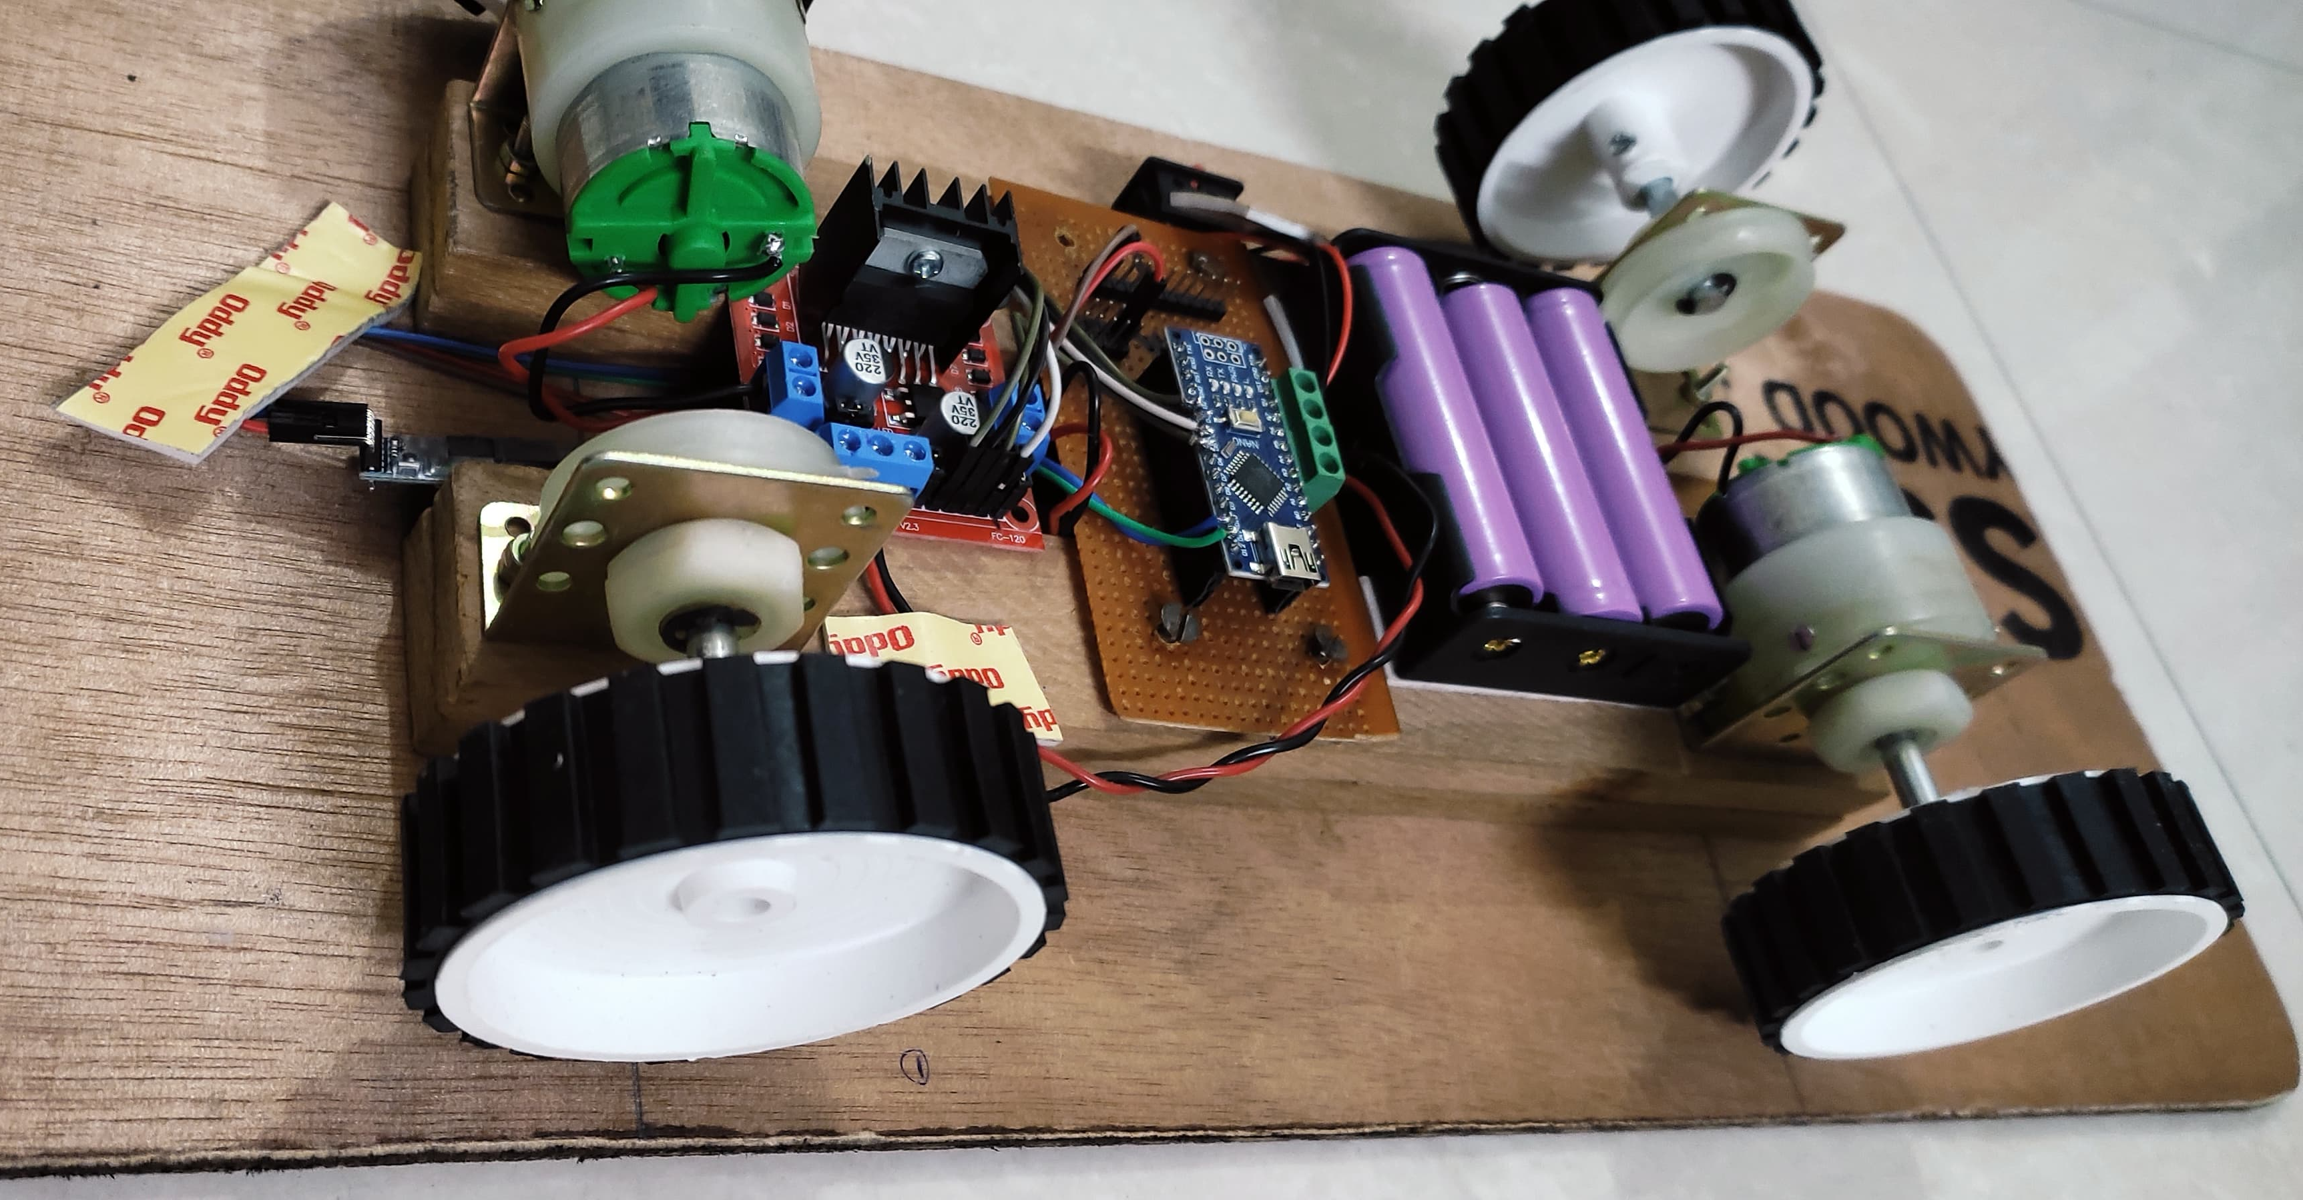
Components Used
Skateboard
Motors
Arduino Nano
L298 Motor Driver
HC-05 Bluetooth Module
Battery
Wires and other items

Slide 4
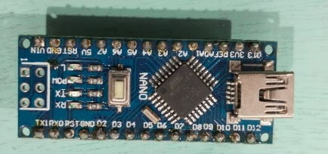
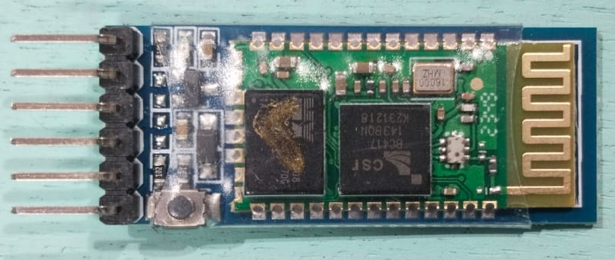
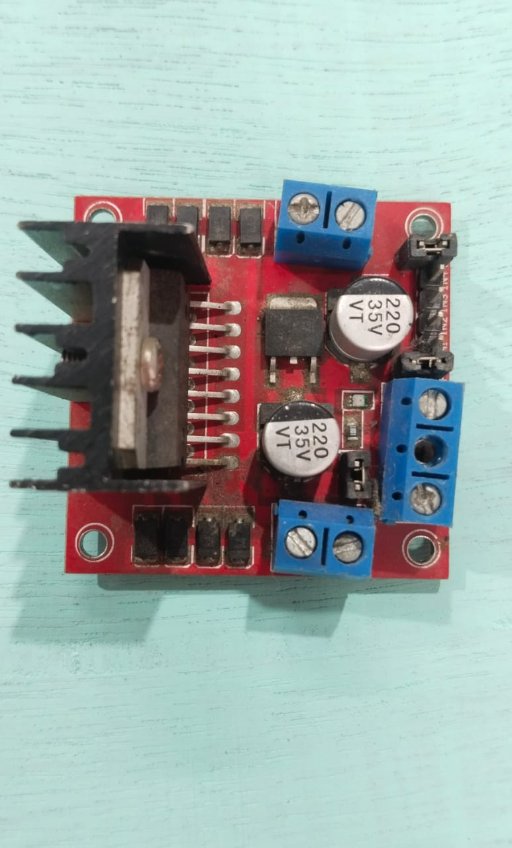
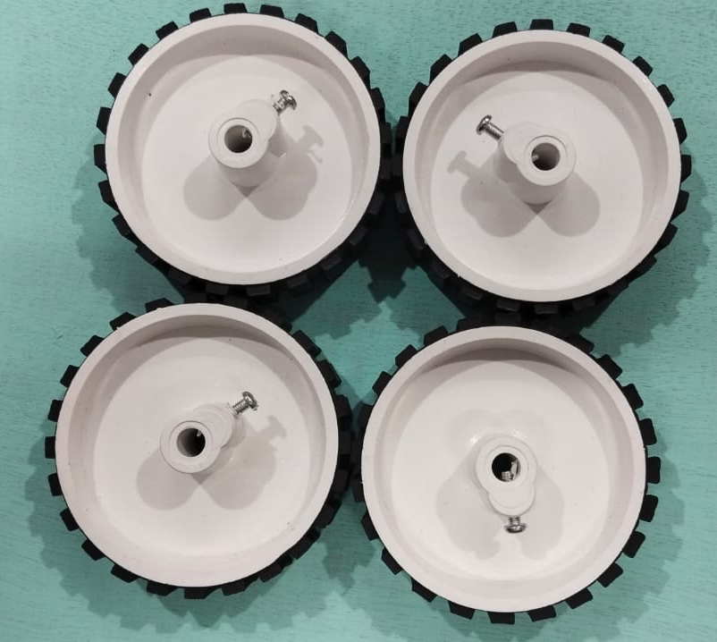
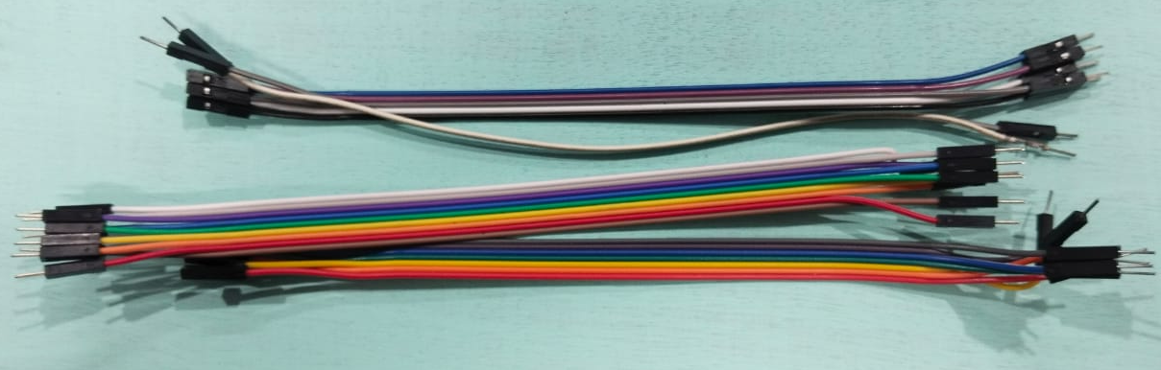
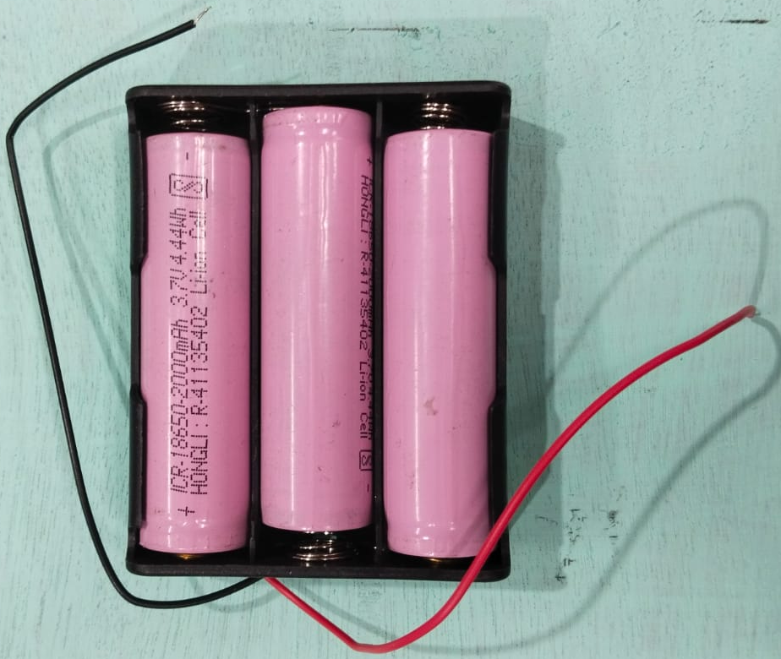
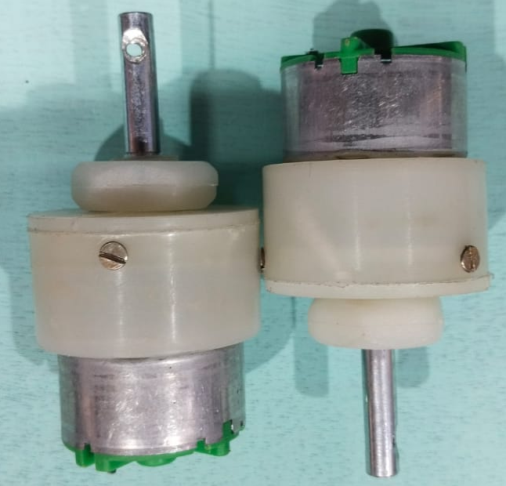
Arduino nano Bluetooth Module HC 05
L298 Motor Driver
Wheels
Motors
Battery
Wires

Slide 5
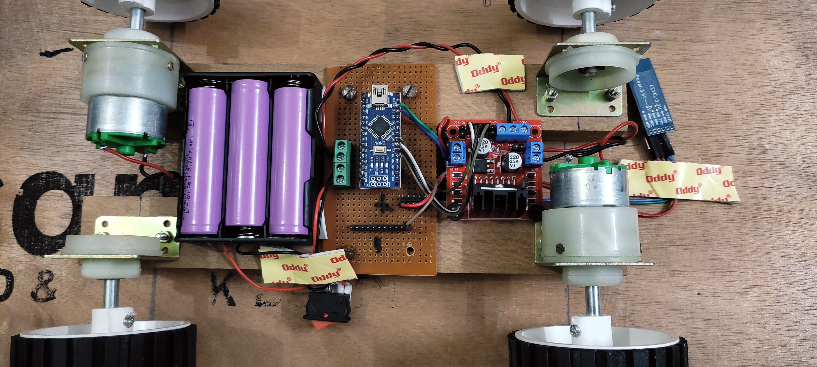
Circuit

Slide 6
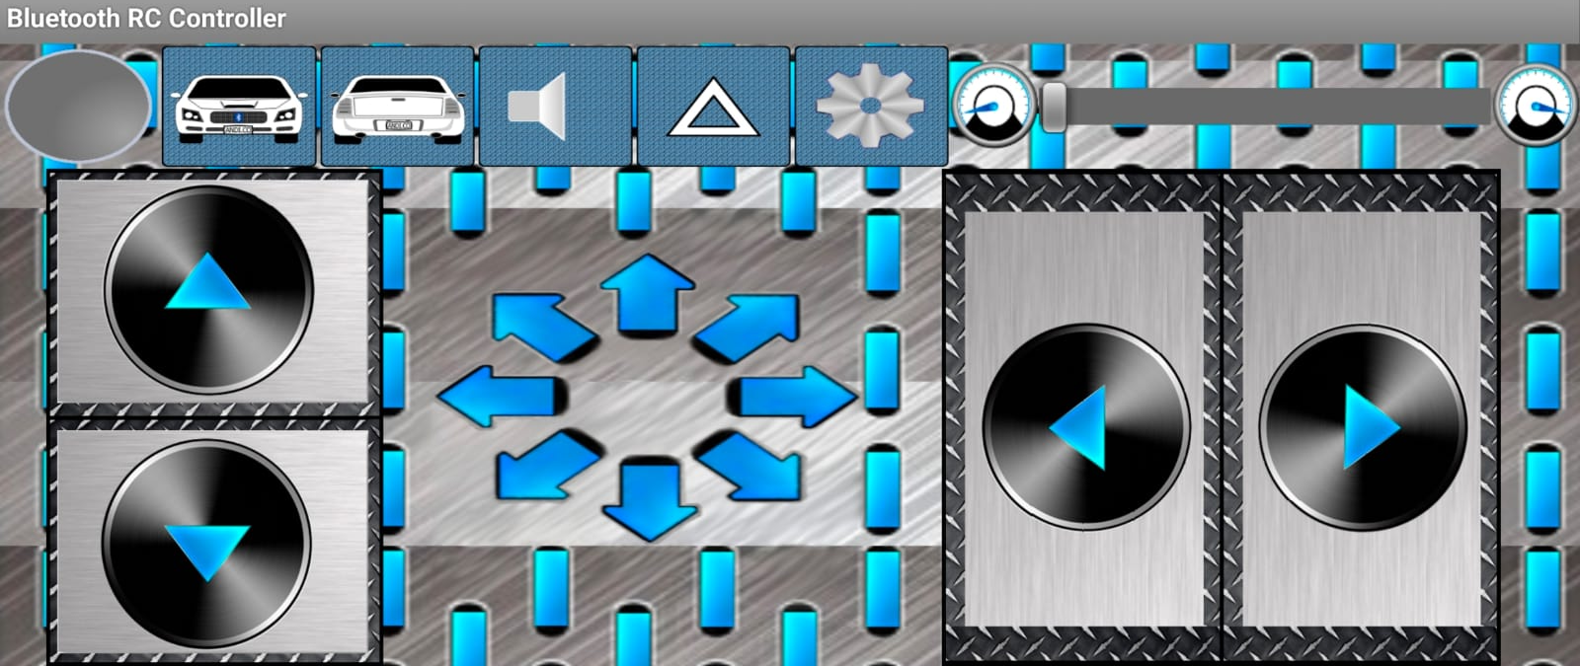
Using a smartphone for control

Slide 7
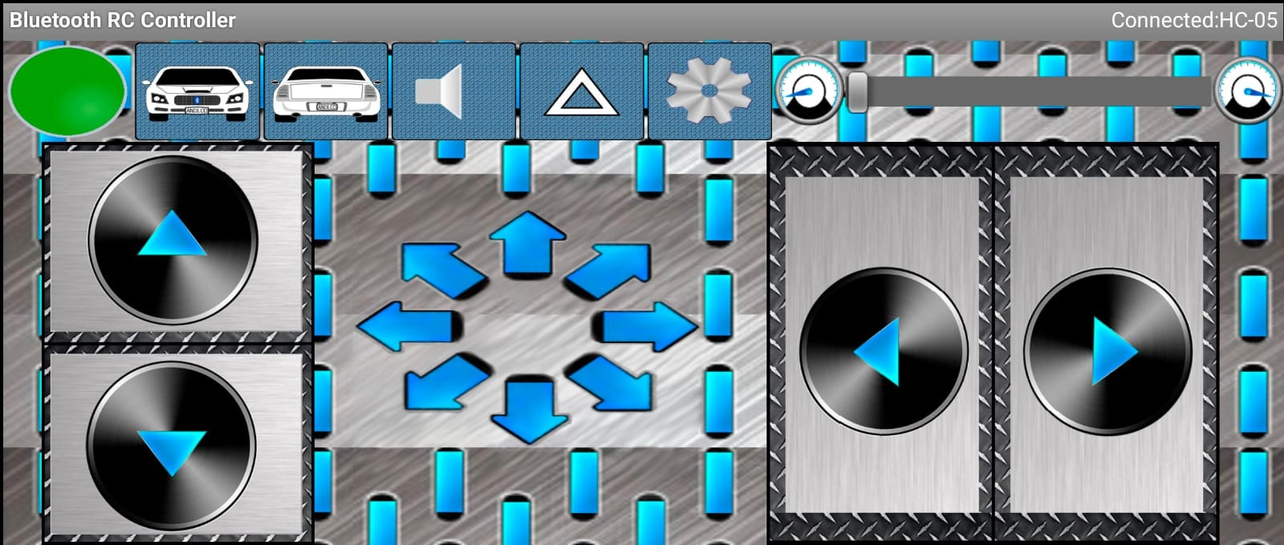
Using a smartphone for control

Slide 8
Future Work :
Enhancement in the android application to detect obstacle to ensure user safety.

Slide 9
THANK YOU.

